Slide 1

Enhancing Customer Experience with AI-Driven Feedback Analysis
Company Name: AI Collaborator
Year: 2025
Name: Youssef Shafeek

Slide 2

Manual feedback processing is too time-consuming due to large volume, making it hard to detect recurring issues and trends in a timely manner.
Problem Statement

Slide 3
Objective - Why we built the system
Our goal: Understand what customers are telling us to map current issues and provide consistent, actionable insights for the team to act on.
We need a reliable system that could:
Handle large columns of customer feedback
Identify sentiment and common themes
Suggest clear next steps for operations
Provide documentation that summarizes everything
AI Collaborator

Slide 4
How The System Works - Multi-Agent System
The system is built with different AI agents each with a focused job. Together, they turn raw customer feedback into a clear report. Here is an overview of each agent:
NLP Processing Agent
Cleans up messy customer comments to make them easier to analyze
Sentiment Agent
Determines the emotional tone for each comment
Summarization Agent
Reviews all the feedback and summarizes the most common themes
AI Collaborator

Slide 5
How The System Works -Multi-Agent System Pt. 2
Insights Agent
Recommends specific actions the business can take based on what customers are saying
Operational Performance Agent
Checks how many customers concerns that needed a response were actually resolved
Document Agent
Compiles all the results into structured report for leadership and teams to review
AI Collaborator

Slide 6
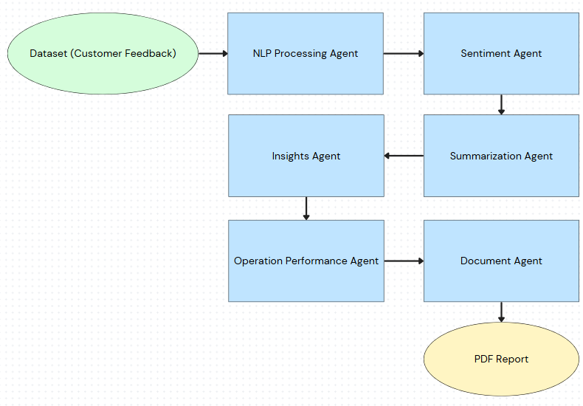
Flow Chart Diagram - LangGraph
AI Collaborator

Slide 7
What the System Produces
Everything produced by the agent is exported to a PDF file, an example is provided in the next couple of slides. The contents of the file:
Processed Feedback example
Sentiment Breakdown
Summarized Feedback Themes
Actionable Insights
Operational Performance Summary
Performance Evaluation
AI Collaborator

Slide 8
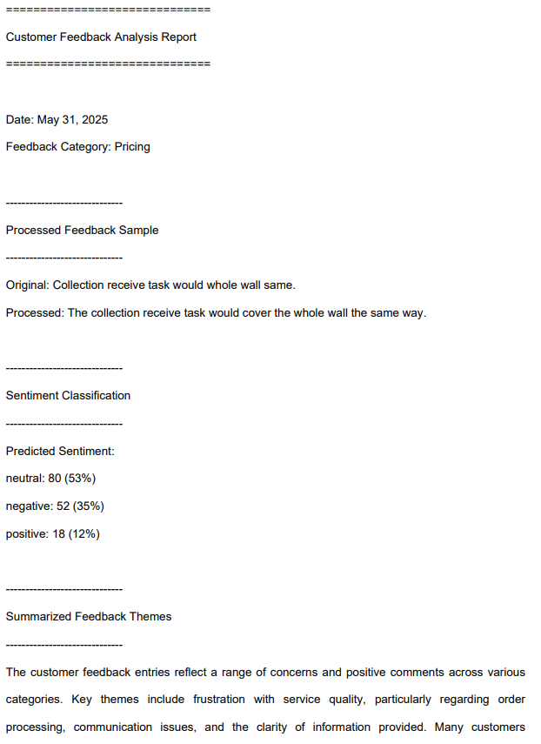
Sample PDF report Pt. 1
When the code is run. It will ask the User to pick a category and the amount of rows to analyze. User can select all. The first page of the pdf shows:
Date and Feedback Category
Example of Processed Feedback
Sentiment Classification
Start of Summarized Feedback Themes
AI Collaborator

Slide 9
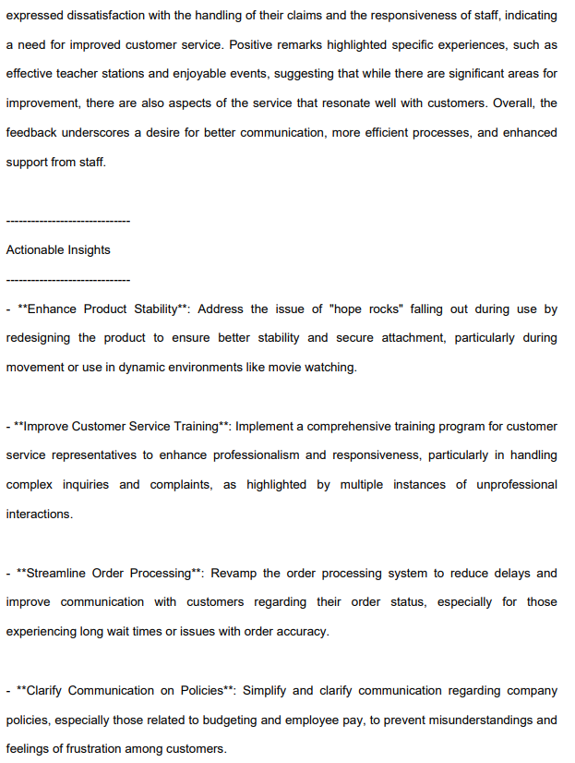
Sample PDF report Pt. 2
The page on the right illustrates:
Continued Summarized Feedback Themes
Actionable Insights
AI agent will provide three to four insights
Tailored for Customer Satisfaction and Product Quality
AI Collaborator

Slide 10
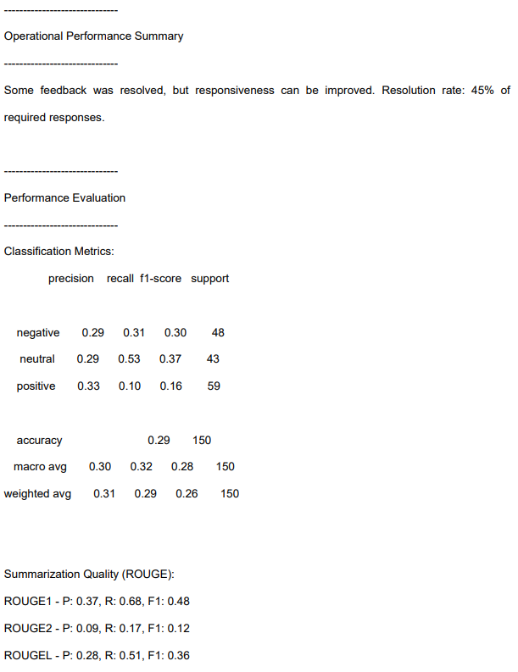
Sample PDF report Pt. 3
This page showcases:
Operational Performance with Resolution Rate
Performance Evaluation
Sentiment Evaluation - Calculation Metrics
Summarization Evaluation - ROUGE scores
AI Collaborator

Slide 11
Performance Evaluation
Sentiment Classification Review
We checked how well the system understands whether feedback is positive, negative or neutral
Comparing to human evaluation about the sentiment even though feedback_text is distorted
Summary Quality Check
We used standard technique called ROUGE to compare the system’s feedback to original feedback. The ROUGE acts like an approximation of how closely the system's summary matches what a human might write.
AI Collaborator

Slide 12
Using the System to Achieve Business Goals
Make Customer Voices Actionable - Instead of letting valuable feedback sit unused, the system converts it into insights your team can act on
Support Strategic Planning - The summarized themes and sentiment trends help leadership identify where to improve products, services and processes
Enhance Customer Satisfaction - Responding to customer concerns more promptly and consistently builds trust and long-term loyalty.
Enable Data-Driven Decisions - By generating structured reports from unstructured data, teams are empowered to make decisions back evidence
AI Collaborator

Slide 13
Future Improvements and Enhancements
While the system is delivering value, there are opportunities to enhance scalability and usability moving forward. Here are some potential areas for improvement:
Sentiment Fine-Tuning – Improve sentiment classification by fine-tuning the model on emotionally mixed or ambiguous feedback.
Visual Sentiment Trends – Add dashboard visualizations of sentiment over time for monthly/quarterly review.
Auto-Routing Insights – Automatically send insights to the relevant operational team for faster action.
Feedback Prioritization – Score feedback based on urgency and impact to help teams focus resources.
AI Collaborator

Slide 14

Any questions?
Ask away!
AI Collaborator

